Slide 1


Bangalore Institute of Technology
DBMS MINI PROJECT
ON
POLICY COLLATE SYSTEM
(INFORMATION SCIENCE & ENGINEERING)
5TH SEM
PRESENTED BY : ADITYA ARYAN
FACULTY INCHARGE : Mrs. ANUPMA KC
PROFESSOR DEPARTMENT OF INFORMATION SCIENCE

Slide 2
Synopsis
Our project is focused on Policy Comparison System for vehicles, which shows information about all different companies providing different policies, such as Company, Policy, Car, Services and other related concepts, such as Premium, and different kinds of Insurance policies. The objective of the project here, is to implement a database management system, such that, it uses the different tables to compare the different policies out there in the market and provide the customers best option.
Using this database can help customers to choose best policy for their vehicle:
• Instant quotes from top insurers.
• Simplifying complex insurance terms and conditions.
• Compare different insurance policies.
• Track any policy on the go.

Slide 3
E-R DIAGRAM
An Entity–relationship model (ER model) describes the structure of a database with the help of a diagram, which is known as Entity Relationship Diagram (ER Diagram).
An ER model is a design or blueprint of a database that can later be implemented as a database. The main components of E-R model are: entity set and relationship set.
E-R SCHEMA
A schema diagram can display only some aspects of a schema like the name of record type, data type, and constraints. Other aspects can’t be specified through the schema diagram.

Slide 4
Entities, Attributes, Key Attributes:
ENTITIES | ATTRIBUTES
COMPANY | COMPANY_ID : INT, COMPANY_NAME : STRING
POLICY | COMPANY_ID : INT, IDV : INT, PREMIUM : INT, MAKE/MODEL : STRING
CAR | COMPANY_ID : INT, MAKE/MODEL : STRING, COLOUR : STRING, YEAR MANUFACTURED: INT
SERVICES | COMPANY_ID : INT, FREE-PICKUP : STRING 24X7 ASSISTANCE : STRING
CLAIM SETTLED | COMPANY_ID : INT, PROGRESS : STRING

Slide 5
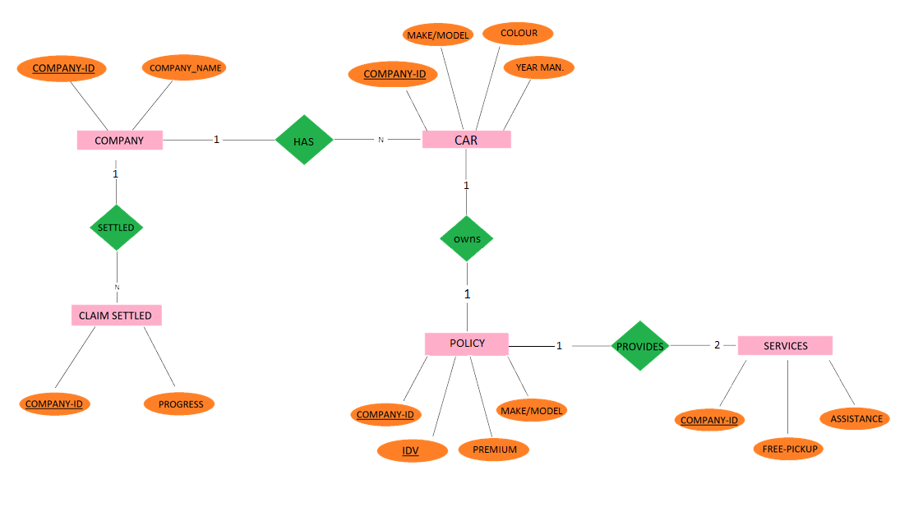
ER-DIAGRAM OF INSURANCE MANAGEMENT SYSTEM

Slide 6
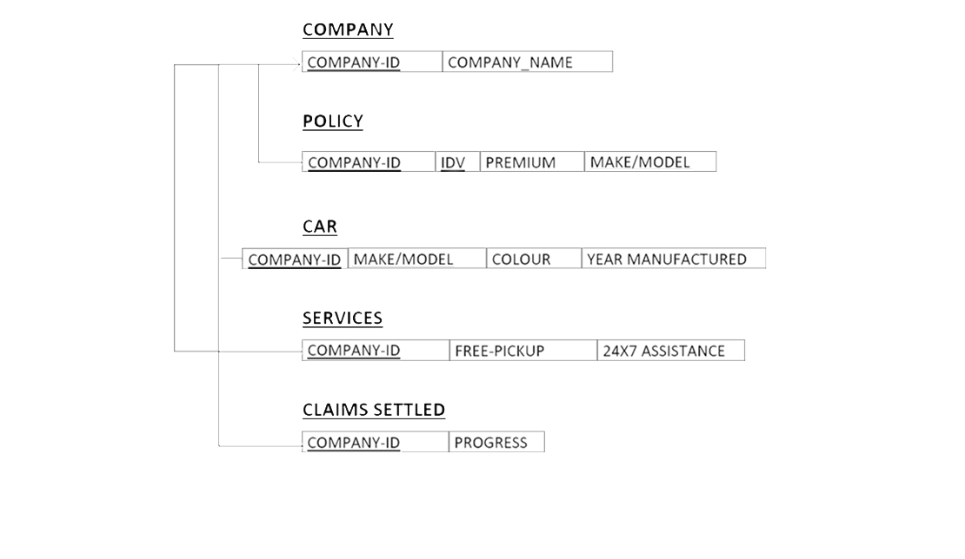
SCHEMA DIAGRAM OF INSURANCE MANAGEMENT SYSTEM

Slide 7
IMPLEMENTATION
Basic Steps in Implementation :
The webpage provides an interface with different policy selling companies in the market.
The owner can add different available companies with the help of the UI.
Provides facilities to the owner to add progress of the company.
The owner can view the list of companies and can update or delete or add new companies as well as other details.

Slide 8
Technologies and Frameworks
HTML
Hypertext Markup Language is the standard markup language for documents designed to be displayed in a web browser. It can be assisted by technologies such as Cascading Style Sheets and scripting languages such as JavaScript.
CSS
Cascading Style Sheets is a style sheet language used for describing the presentation of a document written in a markup language like HTML. CSS is a cornerstone technology of the World Wide Web, alongside HTML and JavaScript. Functional Modules.

Slide 9
Bootstrap
Bootstrap is a free and open-source CSS framework directed at responsive, mobile-first front-end web development. It contains HTML, CSS and JavaScript-based design templates for typography, forms, buttons, navigation, and other interface components.
Tailwind CSS
Tailwind CSS works by scanning all of your HTML files, JavaScript components, and any other templates for class names, generating the corresponding styles and then writing them to a static CSS file.
It's fast, flexible, and reliable — with zero-runtime.

Slide 10
JavaScript
JavaScript, often abbreviated as JS, is a high-level, interpreted scripting language that conforms to the ECMAScript specification. JavaScript has curly-bracket syntax, dynamic typing, prototype-based object-orientation, and first-class functions.
REACT
React is a JavaScript library for building user interfaces. it allows developers to build web and mobile applications using a declarative approach and utilizes a virtual DOM to improve performance. React has a strong ecosystem of third-party libraries and tools that can be used to enhance the functionality of a React application.

Slide 11
Node.js
As an asynchronous event-driven JavaScript runtime, Node.js is designed to build scalable network applications. In the following "hello world" example, many connections can be handled concurrently. Upon each connection, the callback is fired, but if there is no work to be done, Node.js will sleep. Node.js is similar in design to, and influenced by, systems like Ruby's Event Machine and Python's Twisted. Node.js takes the event model a bit further. It presents an event loop as a runtime construct instead of as a library. In other systems, there is always a blocking call to start the event-loop. Typically, behavior is defined through callbacks at the beginning of a script, and at the end a server is started through a blocking call like EventMachine::run(). In Node.js, there is no such start-the-event-loop call. Node.js simply enters the event loop after executing the input script.

Slide 12
PostgreSQL
PostgreSQL is an object-relational database management system (ORDBMS) based on POSTGRES, Version 4.2, developed at the University of California at Berkeley Computer Science Department. POSTGRES pioneered many concepts that only became available in some commercial database systems much later.
PostgreSQL is an open-source descendant of this original Berkeley code. It supports a large part of the SQL standard and offers many modern features:
complex queries
foreign keys
triggers
updatable views
transactional integrity
multiversion concurrency control

Slide 13
NORMALISATION
Normalization is the process to eliminate data redundancy and enhance data integrity in the table. Normalization also helps to organize the data in the database. It is a multi-step process that sets the data into tabular form and removes the duplicated data from the relational tables.
Normalization organizes the columns and tables of a database to ensure that database integrity constraints properly execute their dependencies. It is a systematic technique of decomposing tables to eliminate data redundancy (repetition) and undesirable characteristics like Insertion, Update, and Deletion anomalies.
The database normalization process is further categorized into the following types:
First Normal Form (1 NF);Second Normal Form (2 NF);Third Normal Form (3 NF);
If a database design is not perfect, it may contain anomalies, which are like a bad dream for any database administrator. Managing a database with anomalies is next to impossible.

Slide 14
1.Update anomalies − If data items are scattered and are not linked to each other properly, then it could lead to strange situations. For example, when we try to update one data item having its copies scattered over several places, a few instances get updated properly while a few others are left with old values. Such instances leave the database in an inconsistent state.
2.Deletion anomalies − We tried to delete a record, but parts of it was left undeleted because of unawareness, the data is also saved somewhere else.
3.Insert anomalies − We tried to insert data in a record that does not exist at all.
Normalization is a method to remove all these anomalies and bring the database to a consistent state.

Slide 15
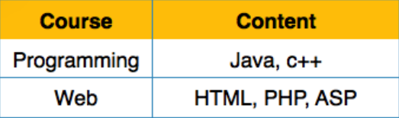
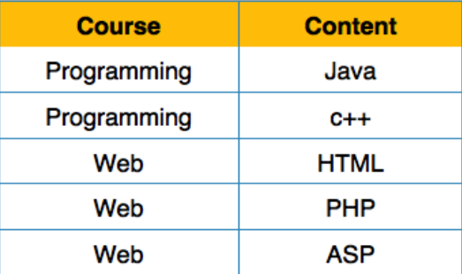
First Normal
Form First Normal Form is defined in the definition of relations tables itself. This rule defines that all the attributes in a relation must have atomic domains. The values in an atomic domain are indivisible units.
We re-arrange the relation table as below, to convert it to First Normal Form.
Each attribute must contain only a single value from its pre-defined domain.

Slide 16
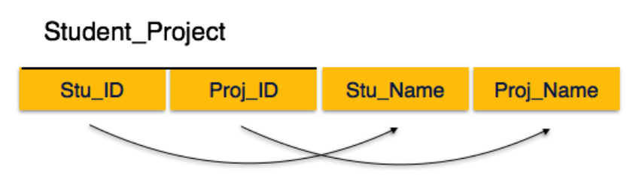
Second Normal Form
Before we learn about the second normal form, we need to understand the following −
1.Prime attribute − An attribute, which is a part of the prime-key, is known as a prime attribute.
2.Non-prime attribute − An attribute, which is not a part of the prime-key, is said to be a non-prime attribute.
If we follow second normal form, then every non-prime attribute should be fully functionally dependent on prime key attribute. That is, if X → A holds, then there should not be any proper subset Y of X, for which Y → A also holds true.
We see here in Student_Project relation that the prime key attributes are Stu_ID and Proj_ID. According to the rule, non-key attributes, i.e. Stu_Name and Proj_Name must be dependent upon both and not on any of the prime key attribute individually. But we find that Stu_Name can be identified by Stu_ID and Proj_Name can be identified by Proj_ID independently. This is called partial dependency, which is not allowed in Second Normal Form.

Slide 17
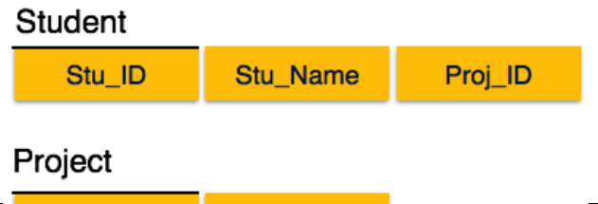

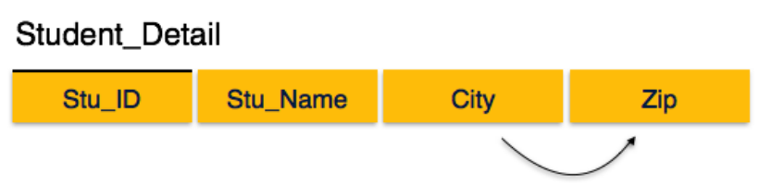
We broke the relation in two as depicted in the above picture. So there exists no partial dependency.
Third Normal Form
For a relation to be in Third Normal Form, it must be in Second Normal form and the following must satisfy −
>No non-prime attribute is transitively dependent on prime key attribute.
>For any non-trivial functional dependency, X → A, then either −
X is a superkey or,
A is prime attribute.

Slide 18
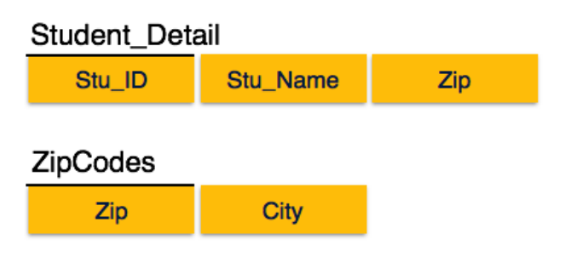
We find that in the above Student_detail relation, Stu_ID is the key and only prime key attribute. We find that City can be identified by Stu_ID as well as Zip itself. Neither Zip is a superkey nor is City a prime attribute. Additionally, Stu_ID → Zip → City, so there exists transitive dependency.
To bring this relation into third normal form, we break the relation into two relations as follows −

Slide 19
FUNCTIONAL DEPENDICIES
Functional dependency FD is a set of constraints between two attributes in a relation. Functional dependency says that if two tuples have same values for attributes A1, A2,..., An, then those two tuples must have to have same values for attributes B1, B2, ..., Bn.
Functional dependency is represented by an arrow sign → that is, X→Y, where X functionally determines Y. The left-hand side attributes determine the values of attributes on the right-hand side.
Armstrong's Axioms
If F is a set of functional dependencies then the closure of F, denoted as F+, is the set of all functional dependencies logically implied by F. Armstrong's Axioms are a set of rules, that when applied repeatedly, generates a closure of functional dependencies.

Slide 20
>Reflexive rule − If alpha is a set of attributes and beta is subset of alpha, then alpha holds beta.
>Augmentation rule − If a → b holds and y is attribute set, then ay → by also holds. That is adding attributes in dependencies, does not change the basic dependencies.
>Transitivity rule − Same as transitive rule in algebra, if a → b holds and b → c holds, then a → c also holds. a → b is called as a functionally that determines b.
Trivial Functional Dependency
>Trivial − If a functional dependency FD X → Y holds, where Y is a subset of X, then it is called a trivial FD. Trivial FDs always hold.
>Non-trivial − If an FD X → Y holds, where Y is not a subset of X, then it is called a non-trivial FD.
>Completely non-trivial − If an FD X → Y holds, where x intersect Y = Φ, it is said to be a completely non-trivial FD.

Slide 21
TRIGGERS
In this article, you will learn about the trigger and its implementation with examples.
A Trigger in Structured Query Language is a set of procedural statements which are executed automatically when there is any response to certain events on the particular table in the database.
Triggers are used to protect the data integrity in the database.

Slide 22
Types of Triggers in SQL
Following are the six types of triggers in SQL:
AFTER INSERT Trigger This trigger is invoked after the insertion of data in the table.
AFTER UPDATE Trigger This trigger is invoked in SQL after the modification of the data in the table.
AFTER DELETE Trigger This trigger is invoked after deleting the data from the table.
BEFORE INSERT Trigger This trigger is invoked before the inserting the record in the table.
BEFOREUP DATE Trigger This trigger is invoked before the updating the record in the table.
BEFORE DELETE Trigger This trigger is invoked before deleting the record from the table.

Slide 23
Triggers used:
Following are the triggers used:
AFTER INSERT Trigger
This trigger is invoked after the insertion of data in the table.
CREATE TRIGGER services_insert
AFTER INSERT ON services
FOR EACH ROW
BEGIN
UPDATE services
SET FREE_PICKUP = 'YES',
ASSISTANCE = 'YES'
WHERE COMPANY_ID = NEW.COMPANY_ID;
END;

Slide 24
STORED PROCEDURES:
A stored procedure is a group of one or more pre-compiled SQL statements into a logical unit. It is stored as an object inside the database server. It is a subroutine or a subprogram in the common computing language that has been created and stored in the database. Each procedure in SQL Server always contains a name, parameter lists, and Transact-SQL statements. The SQL Database Server stores the stored procedures as named objects.
Features of Stored Procedures
Reduced Traffic: A stored procedure reduces network traffic between the application and the database server, resulting in increased performance. It is because instead of sending several SQL statements, the application only needs to send the name of the stored procedure and its parameters.
Stronger Security: The procedure is always secure because it manages which processes and activities we can perform. It removes the need for permissions to be granted at the database object level and simplifies the security layers.
Reusable: Stored procedures are reusable. It reduces code inconsistency, prevents unnecessary rewrites of the same code, and makes the code transparent to all applications or users.
Easy Maintenance: The procedures are easier to maintain without restarting or deploying the application.
Improved Performance: Stored Procedure increases the application performance. Once we create the stored procedures and compile them the first time, it creates an execution plan reused for subsequent executions. The procedure is usually processed quicker because the query processor does not have to create a new plan.

Slide 25
TYPES OF STORED PROCEDURES
They are mainly of two types:
User-defined Stored Procedures
System Stored Procedures
>User-defined Stored Procedures
Database developers or database administrators build user-defined stored procedures. These procedures provide one or more SQL statements for selecting, updating, or removing data from database tables. A stored procedure specified by the user accepts input parameters and returns output parameters. DDL and DML commands are used together in a user-defined procedure.
>System Stored Procedures
The server's administrative tasks depend primarily on system stored procedures. When SQL Server is installed, it creates system procedures. The system stored procedures prevent the administrator from querying or modifying the system and database catalog tables directly. Developers often ignore system stored procedures.

Slide 26
The stored procedure user in our project :
CREATE PROCEDURE SelectAllCompany
AS
SELECT * FROM Company
GO;
EXEC SelectAllCompany;
CREATE PROCEDURE SelectAllCar
AS
SELECT * FROM Car
GO;
EXEC SelectAllCar;

Slide 27
SCREENSHOTS

Slide 28
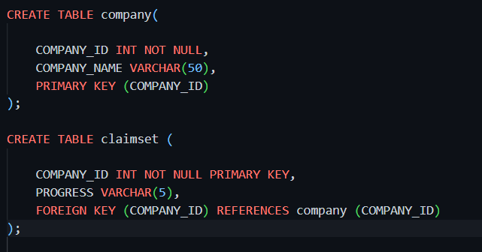
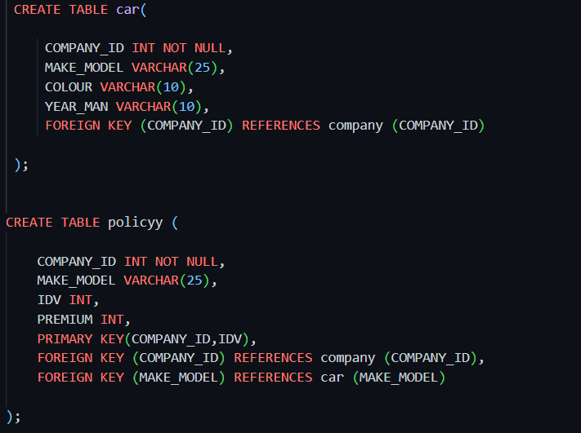
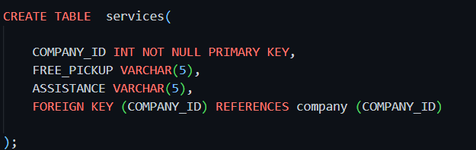
TABLES USED IN OUR APPLICATION

Slide 29
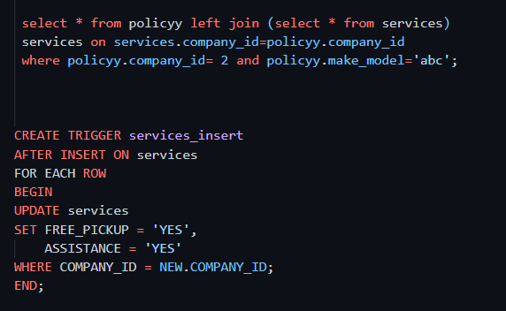
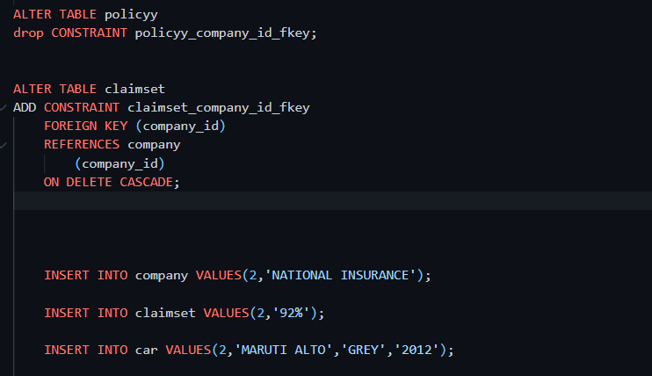
SOME OF THE QUERIES USED

Slide 30
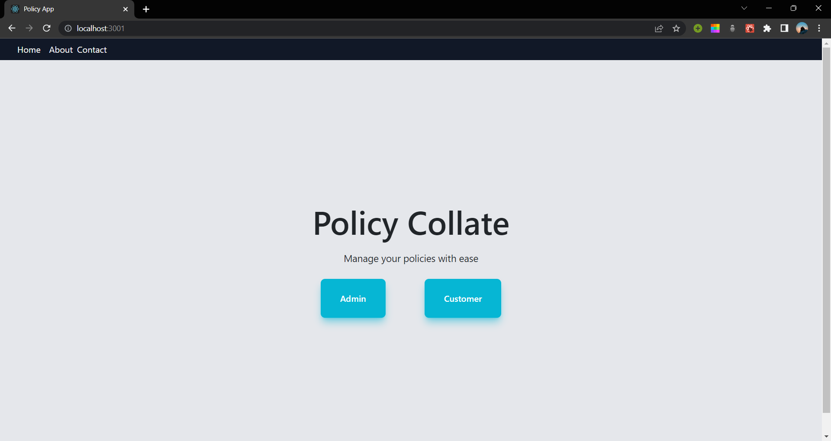
Home Page

Slide 31
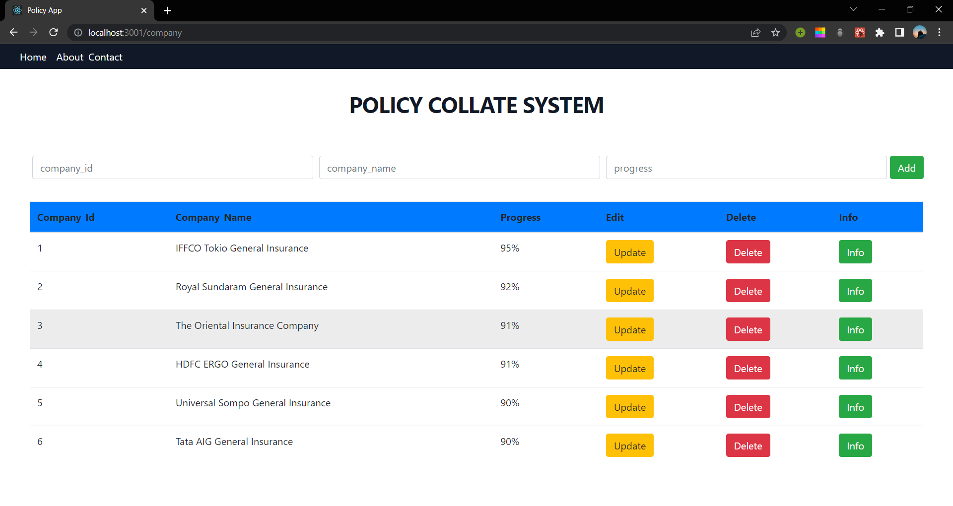
Company Page

Slide 32
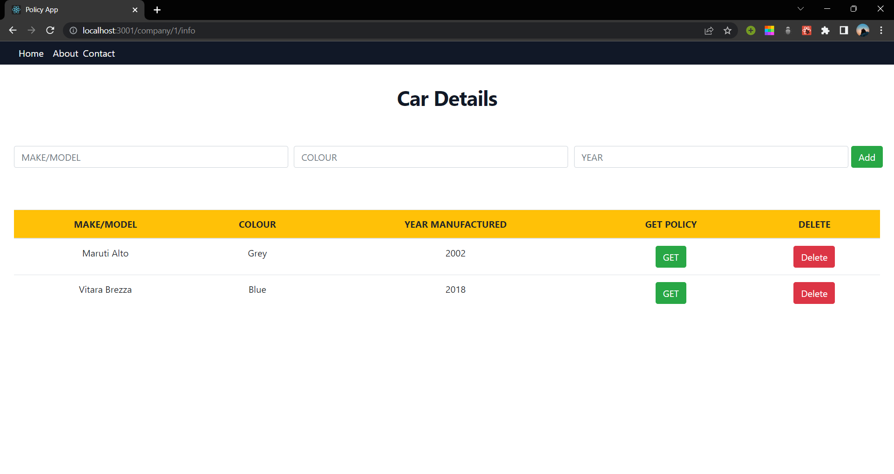
Car Page

Slide 33
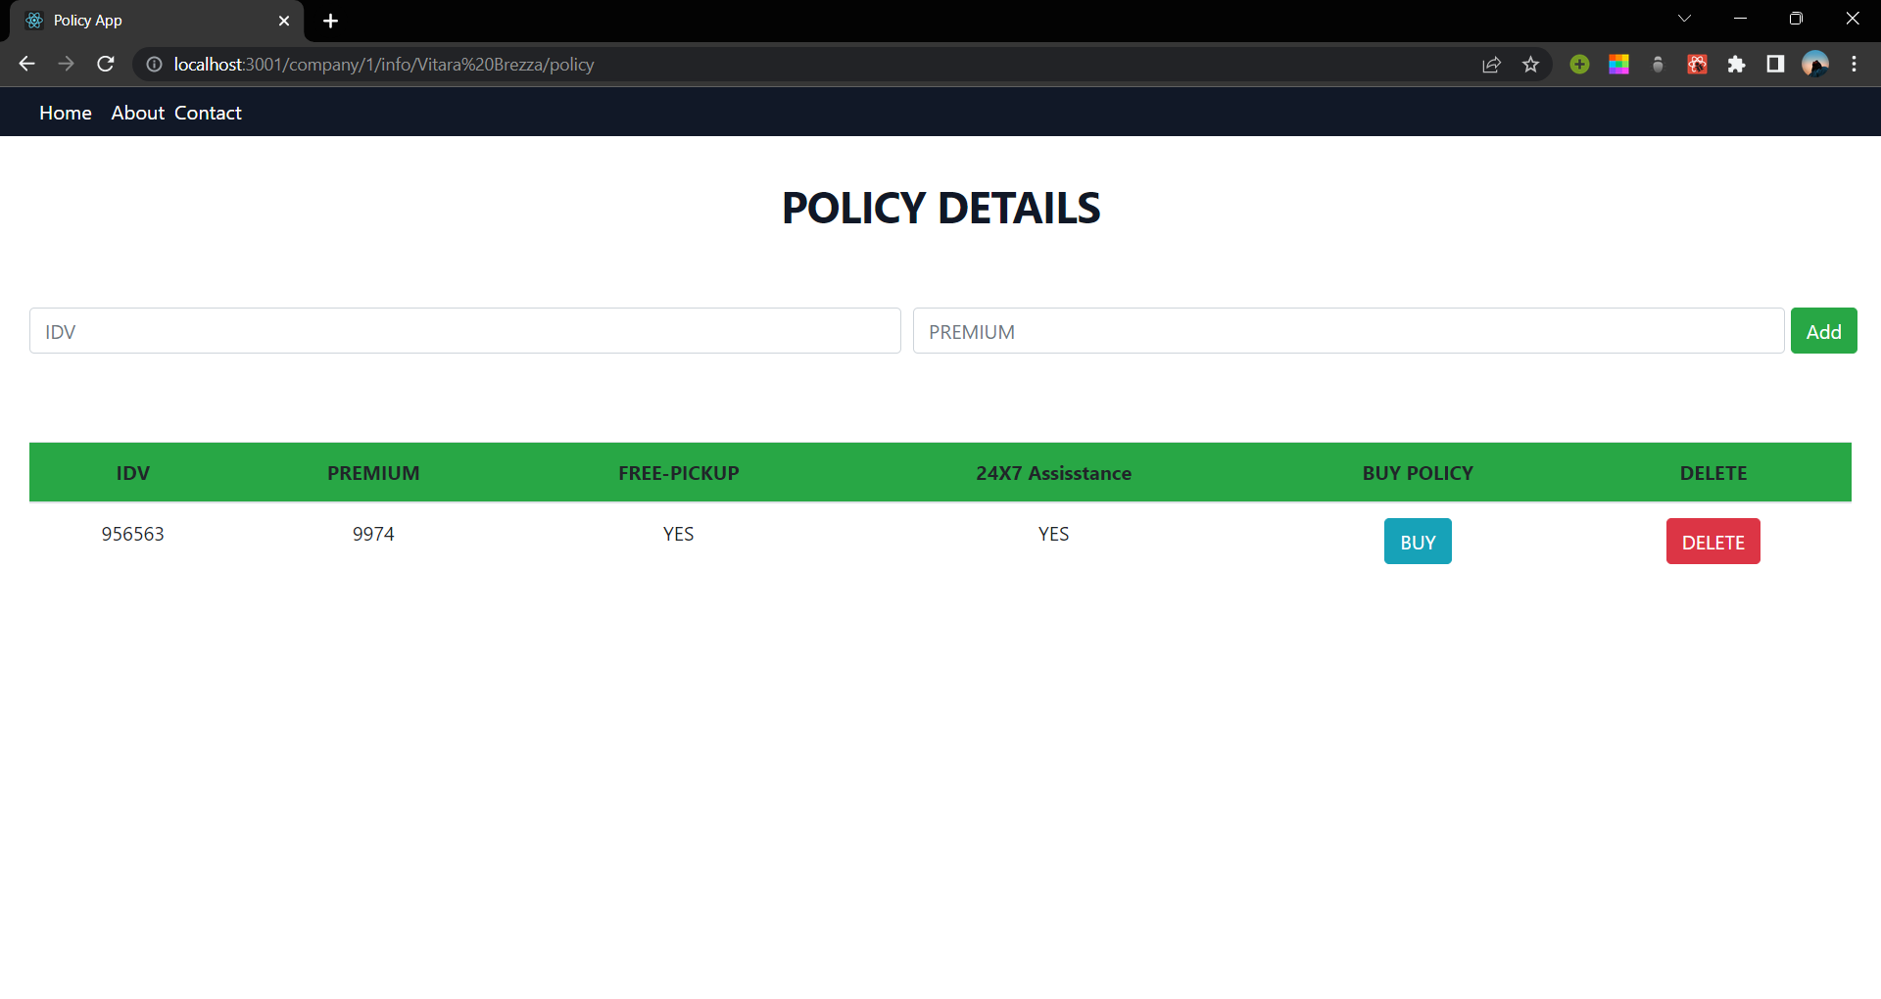
Policy Page

Slide 34
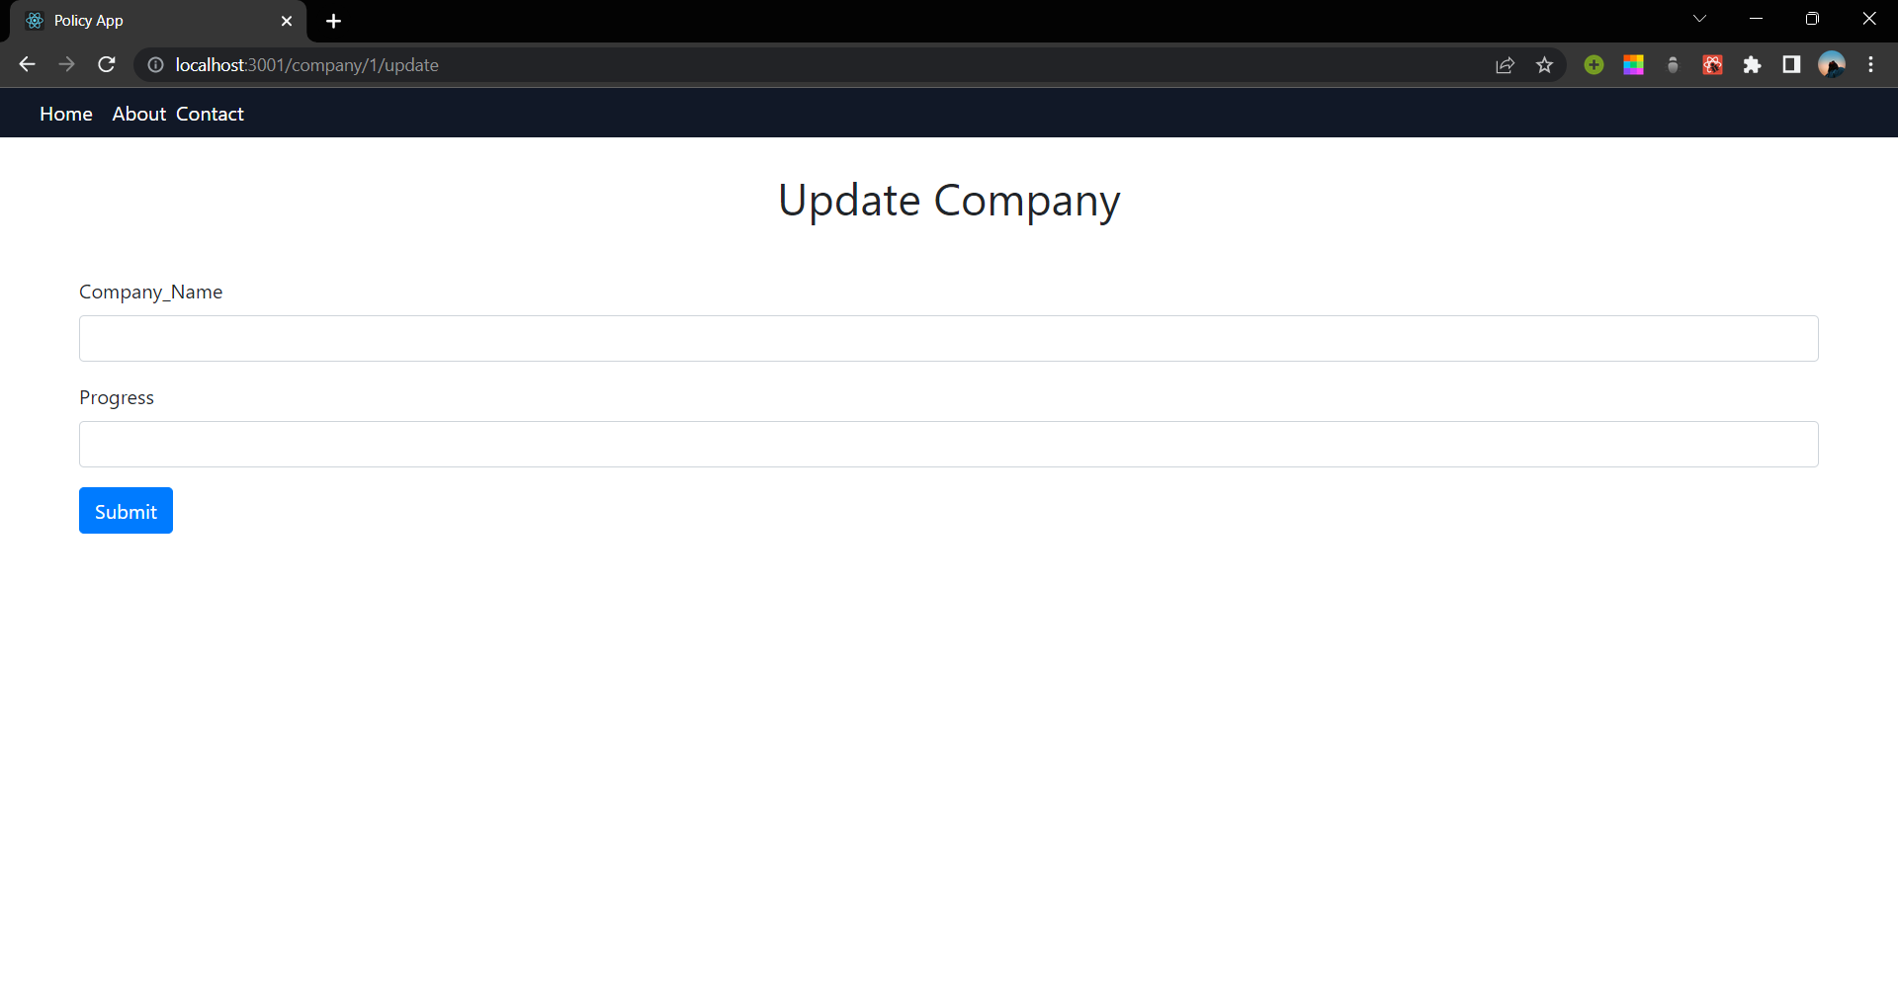
Update Page

Slide 35
THANK YOU

